Slide 1
Multigenerational Travel:
The Process of Pitching

Slide 2
TIMELINE what we will cover: agenda and timeline
where the story begins
1
2
3
4
Overview
observations
Research
numbers & trends
Pitch & Media
the narrative
End
Questions

Slide 3
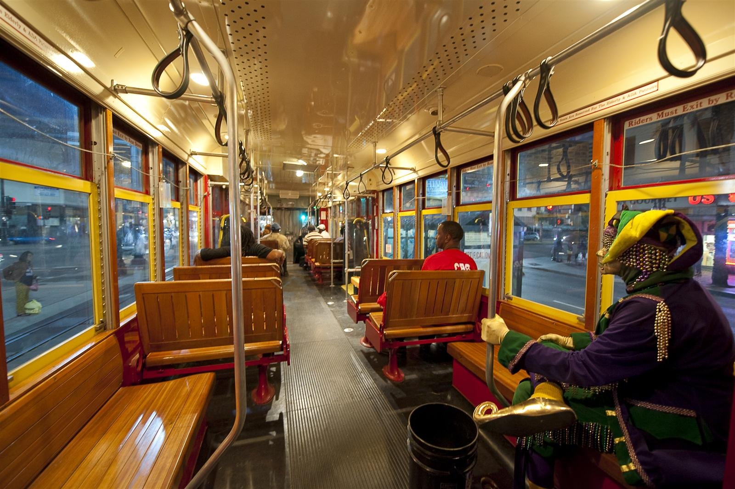
OVERVIEW

Slide 4
PHILOSOPHY basic sum of background and philosophy
Look Inside the Box
Discovering an authentic message
A good media relations professional looks inside the box and whittles a message into a pitch wrapped around an interesting narrative that captivates the attention of editors and journalists

Slide 5
PROCESS how I craft and pitch unique narratives
Targeted Pitches
Begin contacting target list of editors and journalists and offering first opportunity to cover story
Start Spreading
Distribute blanket press release to relevant news outlets that do not require investment of time needed for targeted pitch
Review Notes
when the ideas are born
Research, personal observations and previous conversations with editors and journalists
Unlock the Narrative
Get to the root of the story
Create fact sheet, assemble list of subject matter experts and catalog available photos and video

Slide 6
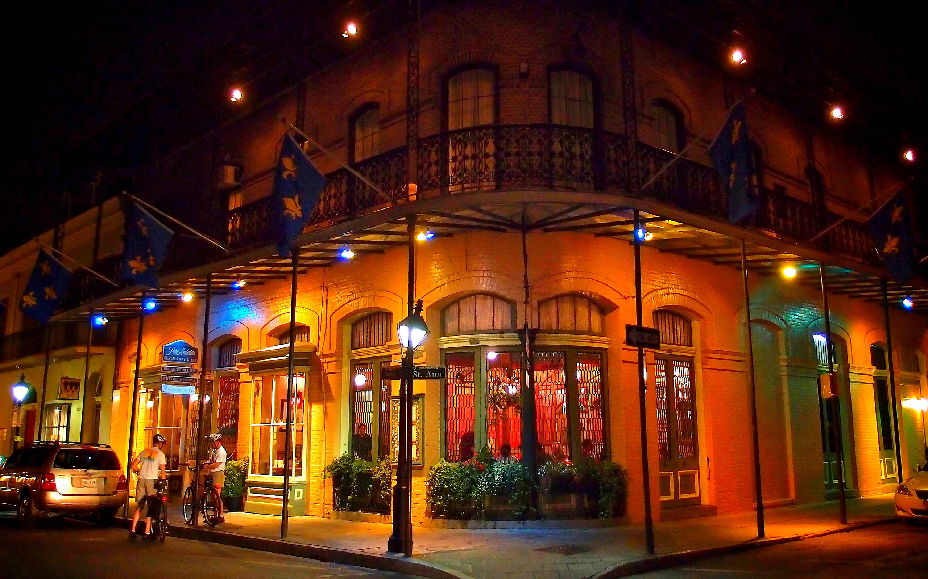
OBSERVATIONS

Slide 7
LAYERS OF NEW ORLEANS common misconceptions from personal observations/conversations
French Quarter
Nightlife, food, music, Bourbon Street, one-stop for adult fun!
Food
Many travel just for the food and don’t understand what other options exist
Jazz
Music lovers rejoice and others just don’t understand and think it is only in bars available for adults
Family Friendly?
It can be, but many families do not know how to experience New Orleans family style!
Truth: You can keep kids engaged, learning and safe in New Orleans.
Cajun cooking school, Audubon Attractions, Mardi Gras World, National World War II Museum

Slide 8
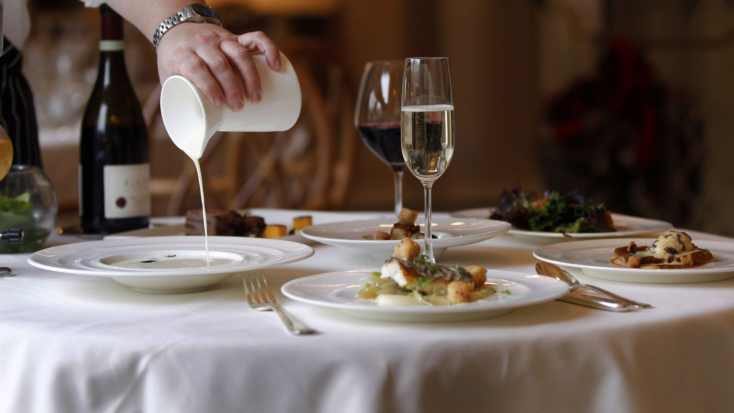
RESEARCH

Slide 9
THE RESEARCH facts, figures and demographics
20.8 million multigenerational trips taken in 2011
According to
Preferred Hotel Group
48.3% of visitors
Age 50 & older
77 Million
Number of Americans turning 65 before 2030
#1 trend is
Multigenerational
Family Travel
50 plus demographic making decisions and supplementing trip costs
Hotel Location Important to 92%
According to
Preferred Hotel Group
4.4 trips per year
Number of multigenerational trips taken per family

Slide 10
NICHE MULTIGENERATIONAL TRAVEL (MGT) specialized target markets
THRIVE
ON MGT
Visitors utilizing the New Orleans cruise port stay an average of 2.2 days before or after their cruise
HIGHEST FORM
Families like to be together at holidays and create memories
CRUISE
HOLIDAY
MGT
ANOTHER MAIN DRIVER
Families celebrate anniversaries, birthdays, and other milestone events
QUICKLY GROWING
Starting to travel as family units due to increase in states offering legal marriage and adoptions
MILESTONE
LGBT

Slide 11
COMPONENTS OF MGT connect all generations in central location
PARENTS
Escape from kids
Time to relax, shop and hit spa
Peace of mind
KIDS
Hands-on
Educational
Safe drop-off activities or care facilities
$
HOTEL
CENTER OF IT ALL!
GRANDPARENTS
Create memories
Spend time with grandchildren
Will pay for the right accommodations and group friendly activities

Slide 12
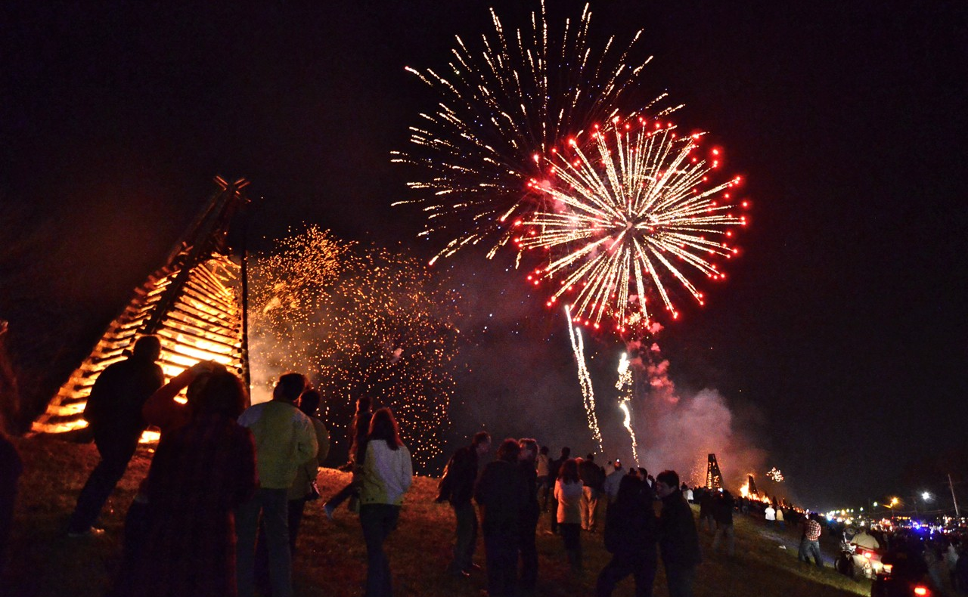
THE PITCH

Slide 13
MULTIGENERATIONAL TRAVEL Christmas in New Orleans
St. Louis Christmas Concerts
Bonfires on the Levee
Caroling in Jackson Square
Santa’s Secret Workshop
Celebration in the Oaks or
Roosevelt Hotel Lobby Lights
Hermann-Grima House
Cooking Up Christmas
French Market Holiday
Marching Bands
Christmas Eve at Audubon Attractions
SHOPPING
The Outlet Collection at Riverwalk, Magazine Street and French Quarter

Slide 14
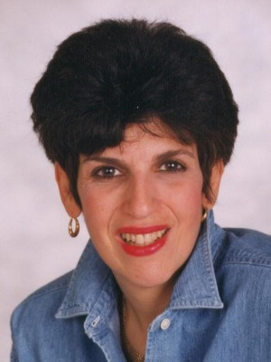
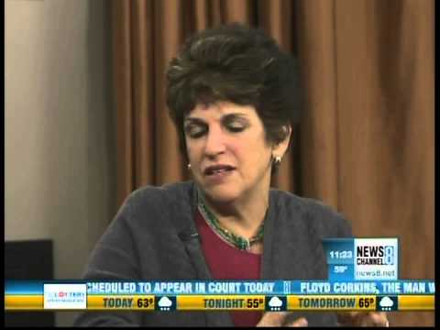
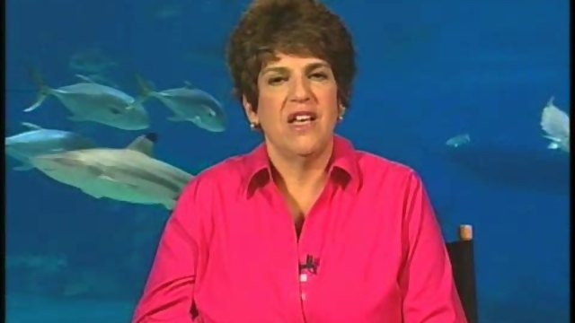
EILEEN OGINTZ “Taking the Kidz” – Tribune Media Services
Image
Placeholder 1
Internationally syndicated with extensive reach in Florida, California and Texas
Leading family travel expert as seen on The Today Show, Oprah, CNBC, Foxnews.com, and Good Morning America

Slide 15
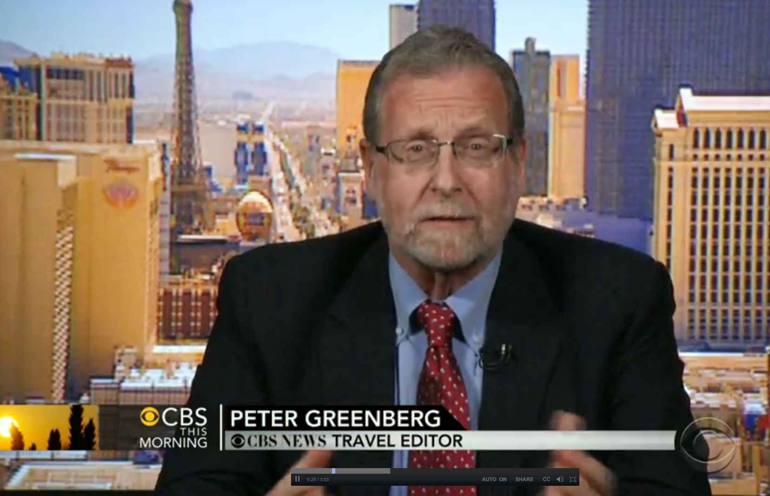
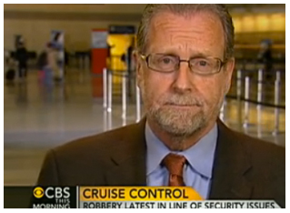
PETER GREENBERG CBS News Travel Editor
CBS Travel Editor
Active on social media with more than 215k Twitter followers
Loves tips, tricks and behind the scenes type of stories
Great weight placed on his travel tips for safety

Slide 16
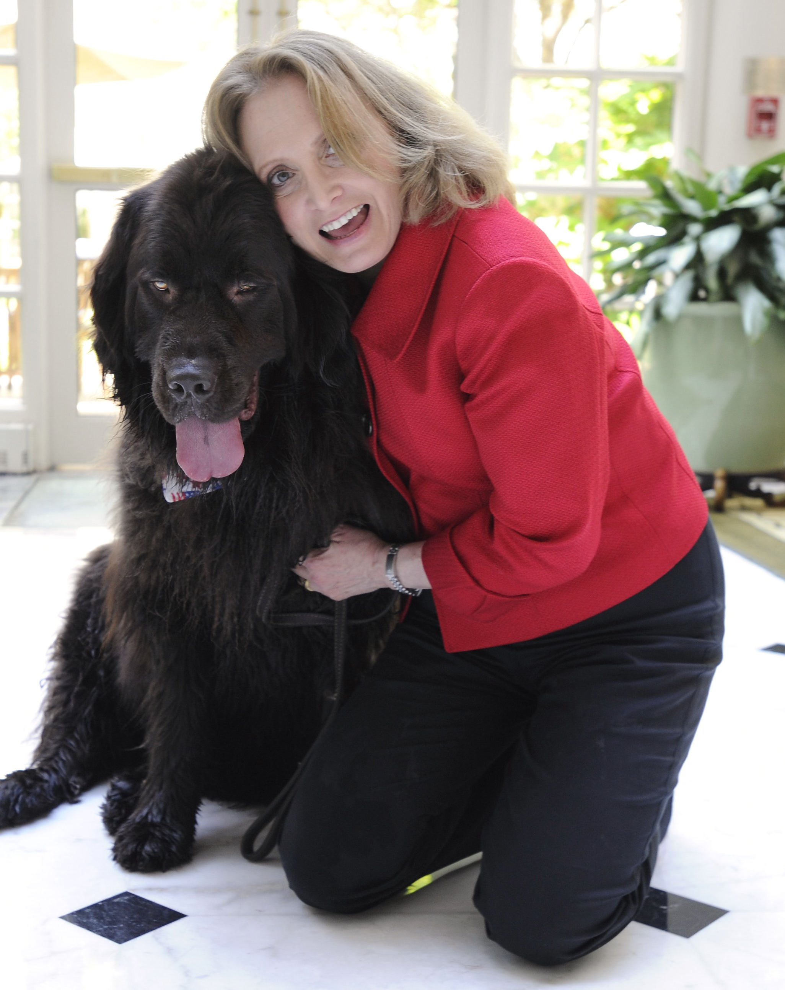
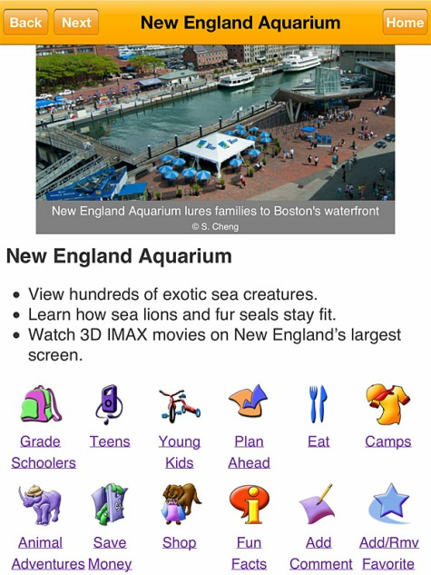
CANDYCE STAPEN USA Today, Familyitrips Apps, and author of 30 travel books
Considered a family travel expert
Written about multigenerational travel for USA Today
Written two travel books for National Geographic

Slide 17
Questions
Please don’t hesitate

Slide 18
Thank You
for your undivided attention

